Slide 1

Plymouth Public Schools
College, Career & Technical Education
School Committee Presentation
February 12, 2024
Allied Health
Automotive
Carpentry
Computer Aided Drafting(CAD)
Cosmetology
Culinary Arts
Early Education & Care
Electrical
Engineering Technology
Facilities Management
Graphic Design & Visual Communication (GDVC)
Heating, Ventilation, & Air Conditioning (HVAC)
Marketing (PNHS & PSHS)
Medical Assisting
Plumbing

Slide 2
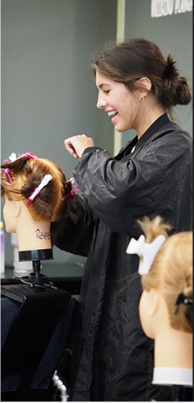
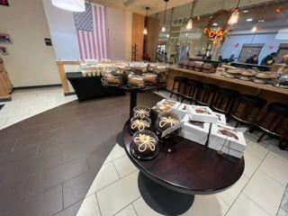
CCTE Highlights 2023 - 2024
Culinary Arts
All sophomores passed the ServSafe Exam & Allergen Exam
Catered our Advisory Dinner & Football Banquet
Broke sales records for the Harvest Market
Hosted the annual Daughters of the American Revolution Luncheon
Cosmetology
All seniors have met the 1000 hours required by the Board of Cosmetology and can sit for their Cosmetology Exam
Salon Tours, Guest Speakers & Demos
International Beauty Show in New York City

Slide 3
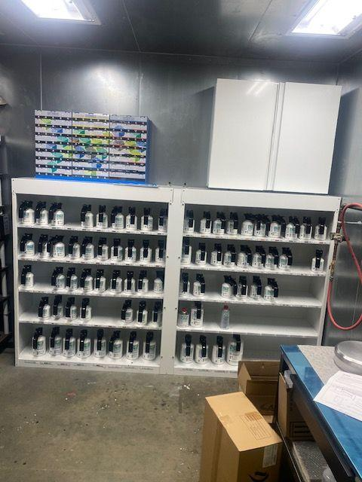
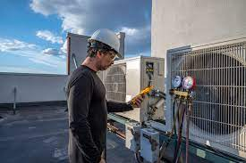
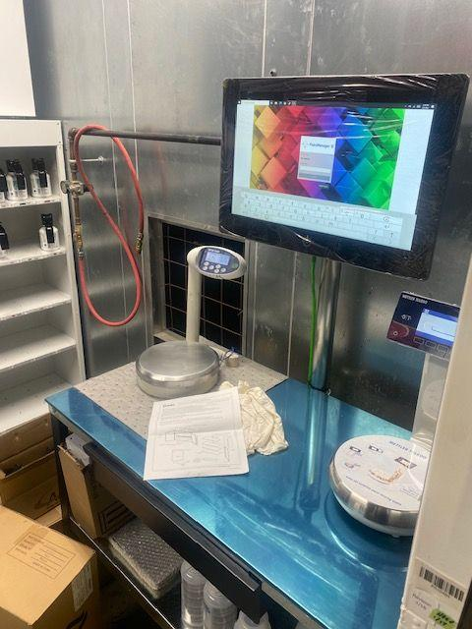
CCTE Highlights 2023 - 2024
HVAC
All Sophomores OSHA10 certified
All Juniors EPA 608 certified
CO-OP: Commercial HVAC all aspects of the commercial trade
Automotive
All students OSHA10 certified
Juniors and seniors are taking ASE exams (Automotive Service Excellence)
Transportation received $22,000 waterborne paint system donated
by Colours INC. of Plymouth.

Slide 4


CCTE Highlights 2023 - 2024
CAD
Signage & banners for the Plymouth Garden Club & Farm House Project. Stencil pattern for the Plymouth Youth Football concession stand at Forges Field.
Fire Exit escape map plans for Harbor Academy (requested by PFD)
Year two of Engineering Club (21 students strong)
GDVC
Taylor Gendron won The Greatest Save G.O.A.T. PSA national competition (best in 10 years)
Jacob Ohlson finished in the top 5 in the nation for the Category of "News Story" from the National Academy of Arts & Sciences (Emmy) for his story on Life in Ukraine during a War.

Slide 5
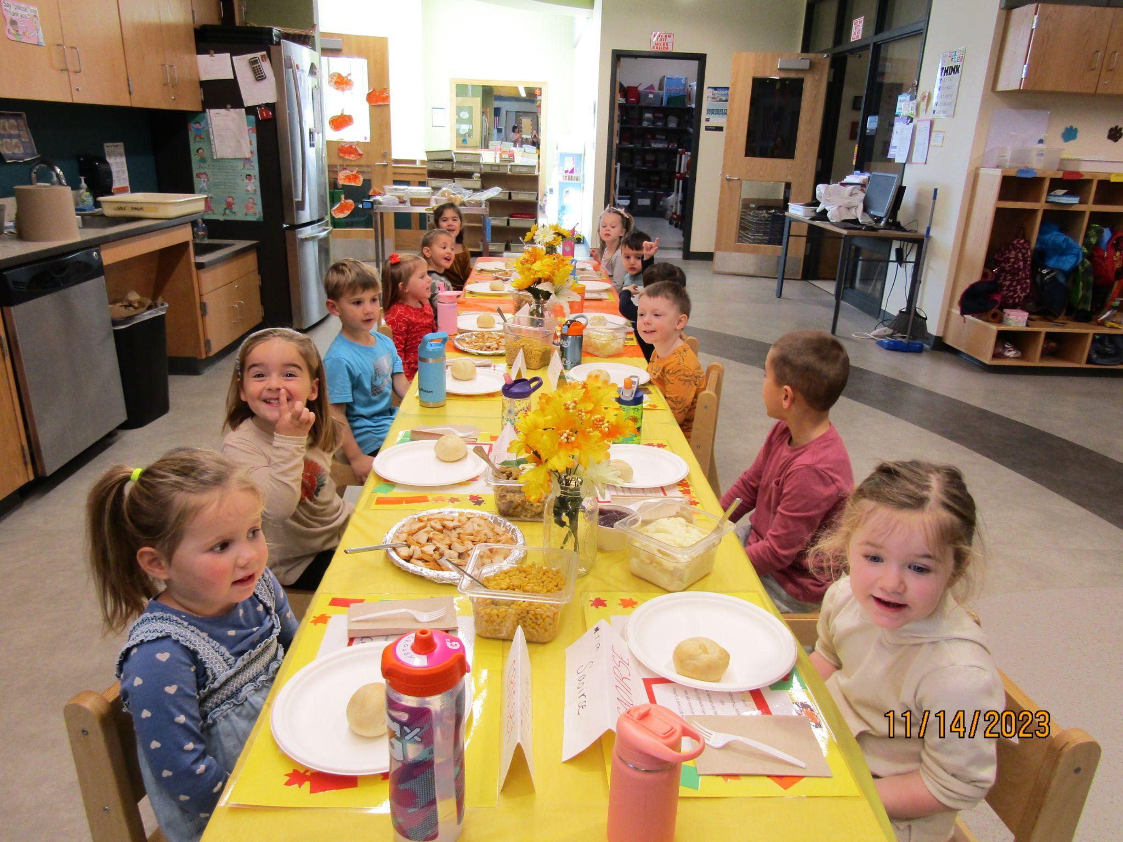
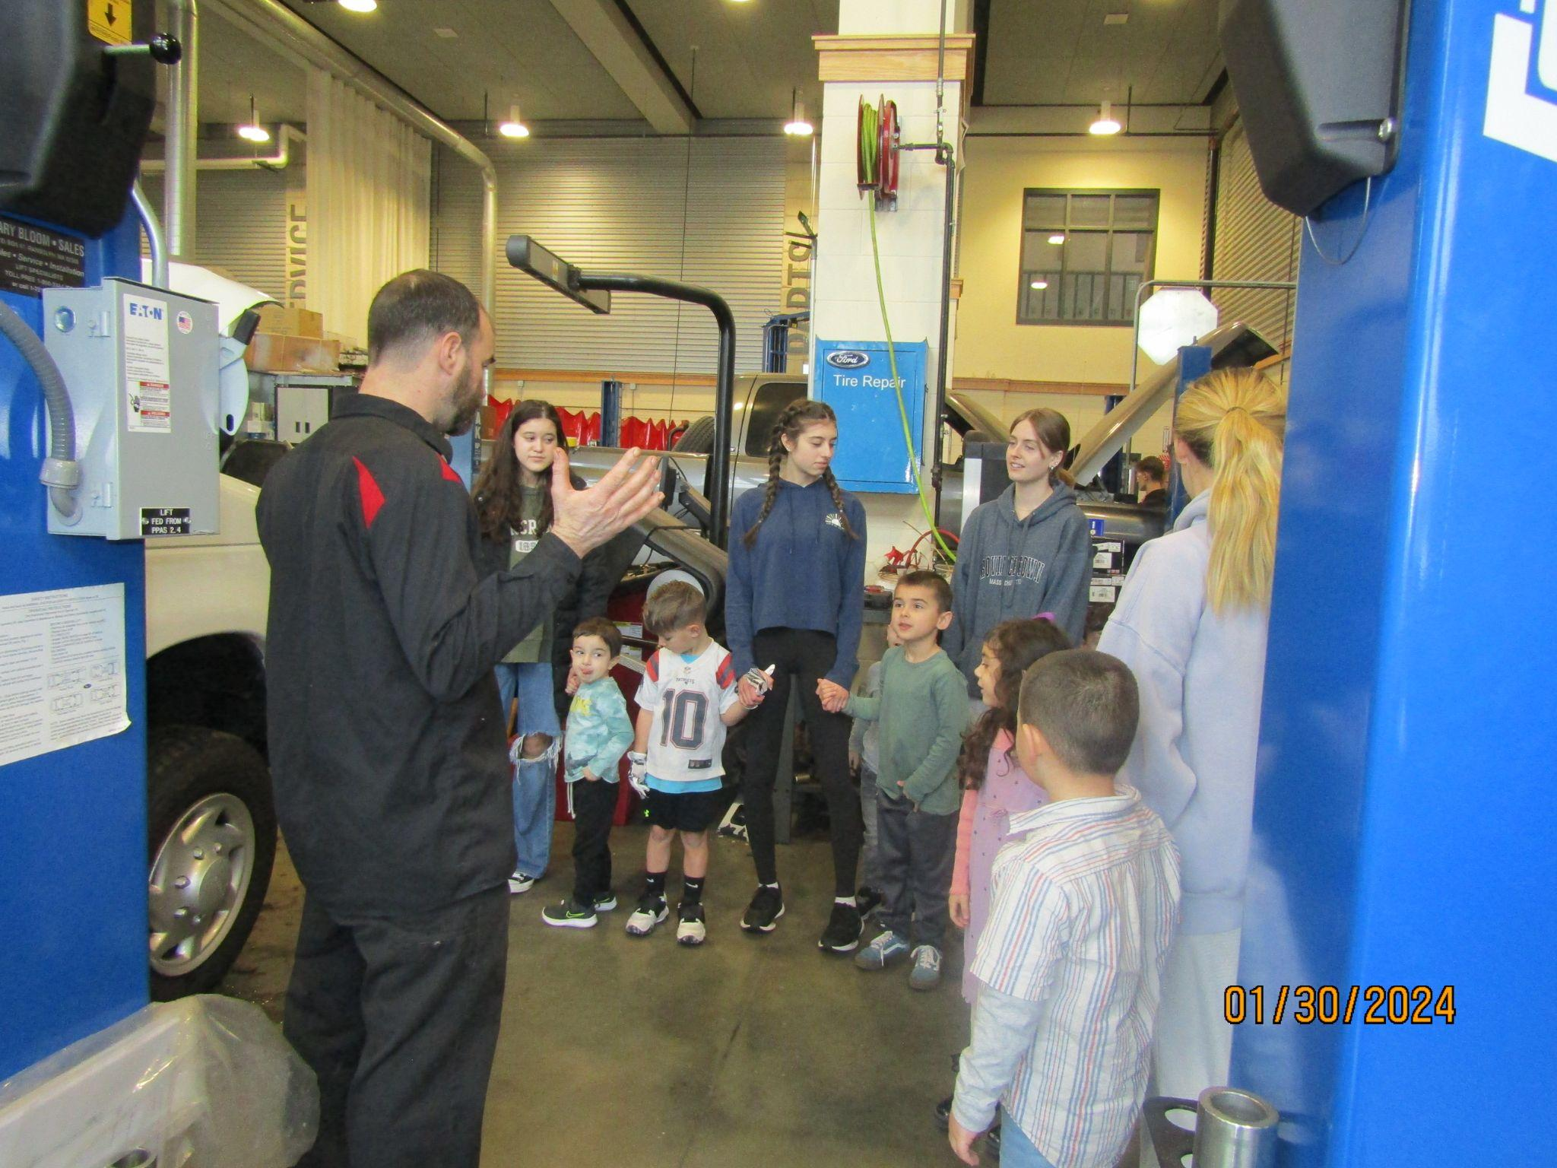
CCTE Highlights 2023 - 2024
Early Education & Care
The entire curriculum at Panthers' Cubhouse is planned and implemented by the high school students daily. The preschool has a theme of the week and letter of the week. We highlight aspects of the curriculum: math, literacy, science and theme.
February Theme: Community Helpers visiting our CCTE shops

Slide 6

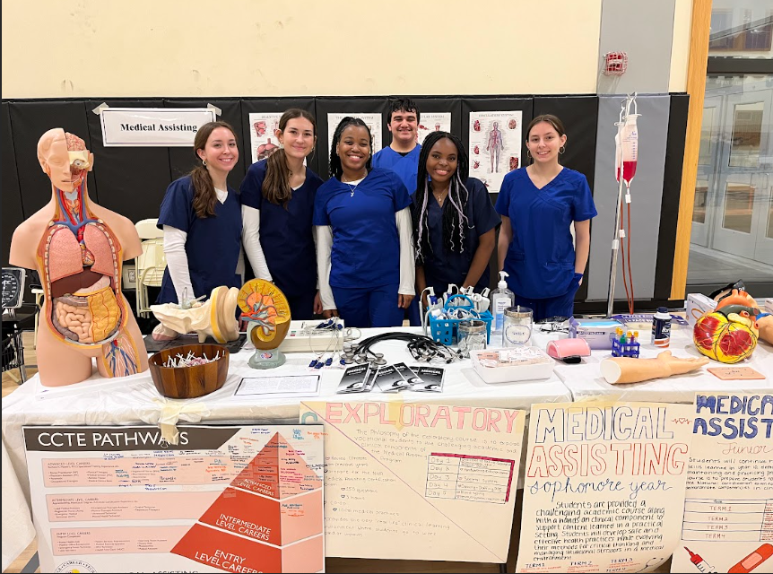
CCTE Highlights 2023 - 2024
Medical Assisting
15 seniors passed their CCMA exam
2nd Annual Staff Blood Pressure Clinic (Juniors)
Allied Health
Juniors have started their clinical, working towards the required hours to take the state exam, and have earned their BLS CPR Certification.
Sophomores have researched and demonstrated how they would care for and educate their patient in order to achieve the best outcomes (evidence based research best practices and how they are utilized and applied in healthcare).

Slide 7
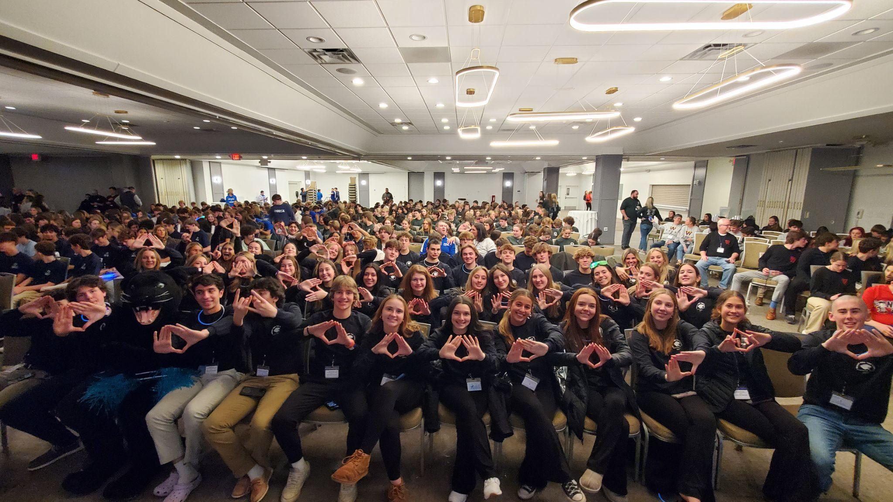
CCTE Highlights 2023 - 2024
PSHS Marketing
Seniors ran the annual Lights of Hope event and raised over $5k for Beth Israel Deaconess Cancer Center.
Marketing students competed at DECA districts in Falmouth and brought home 24 medals and 22 trophies
PNHS Marketing
140 students competed at the DECA District Competition with 67 students qualifying to compete at the MA DECA State Career Development Conference held in Boston next month.
Senior project theme is giving back to the community and includes: combating eating disorders, introducing personal finance to middle school students, suicide prevention and awareness, creating marketing campaigns for local businesses and climate change awareness

Slide 8
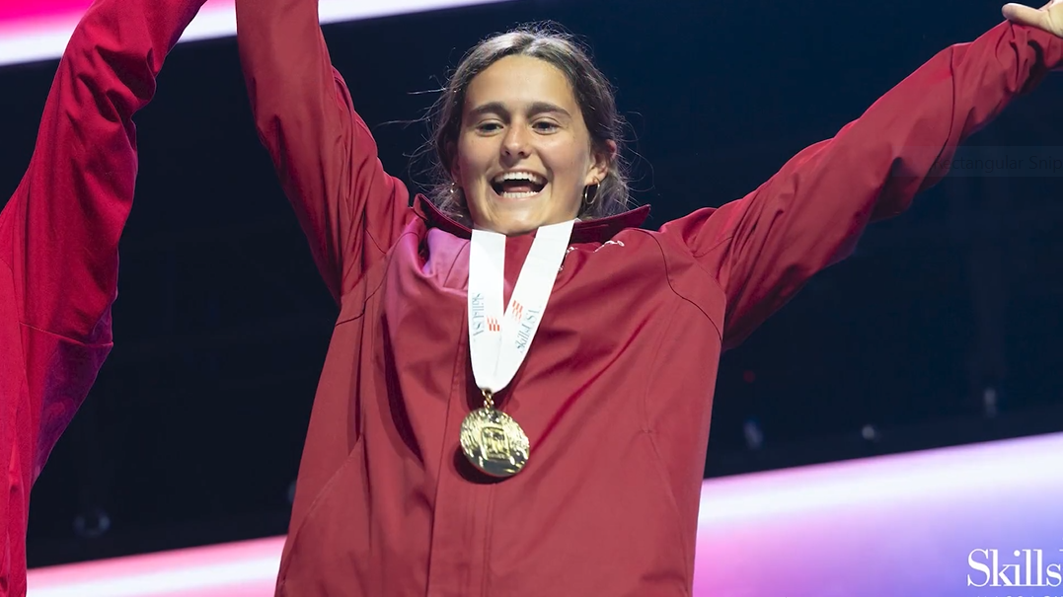
CCTE Highlights 2023 - 2024
Facilities Management
All students OSHA 10 Construction Certified
Drywall & drywall repairs, painting intro, interior finish carpentry, tile install & repairs
Joint project with Engineering students to design & build trebuchets.
Team builds, steel pipe work, individual senior project work,building management systems & controls
2023 SkillsUSA National Champion: Facilithon - Annalise Lopes

Slide 9
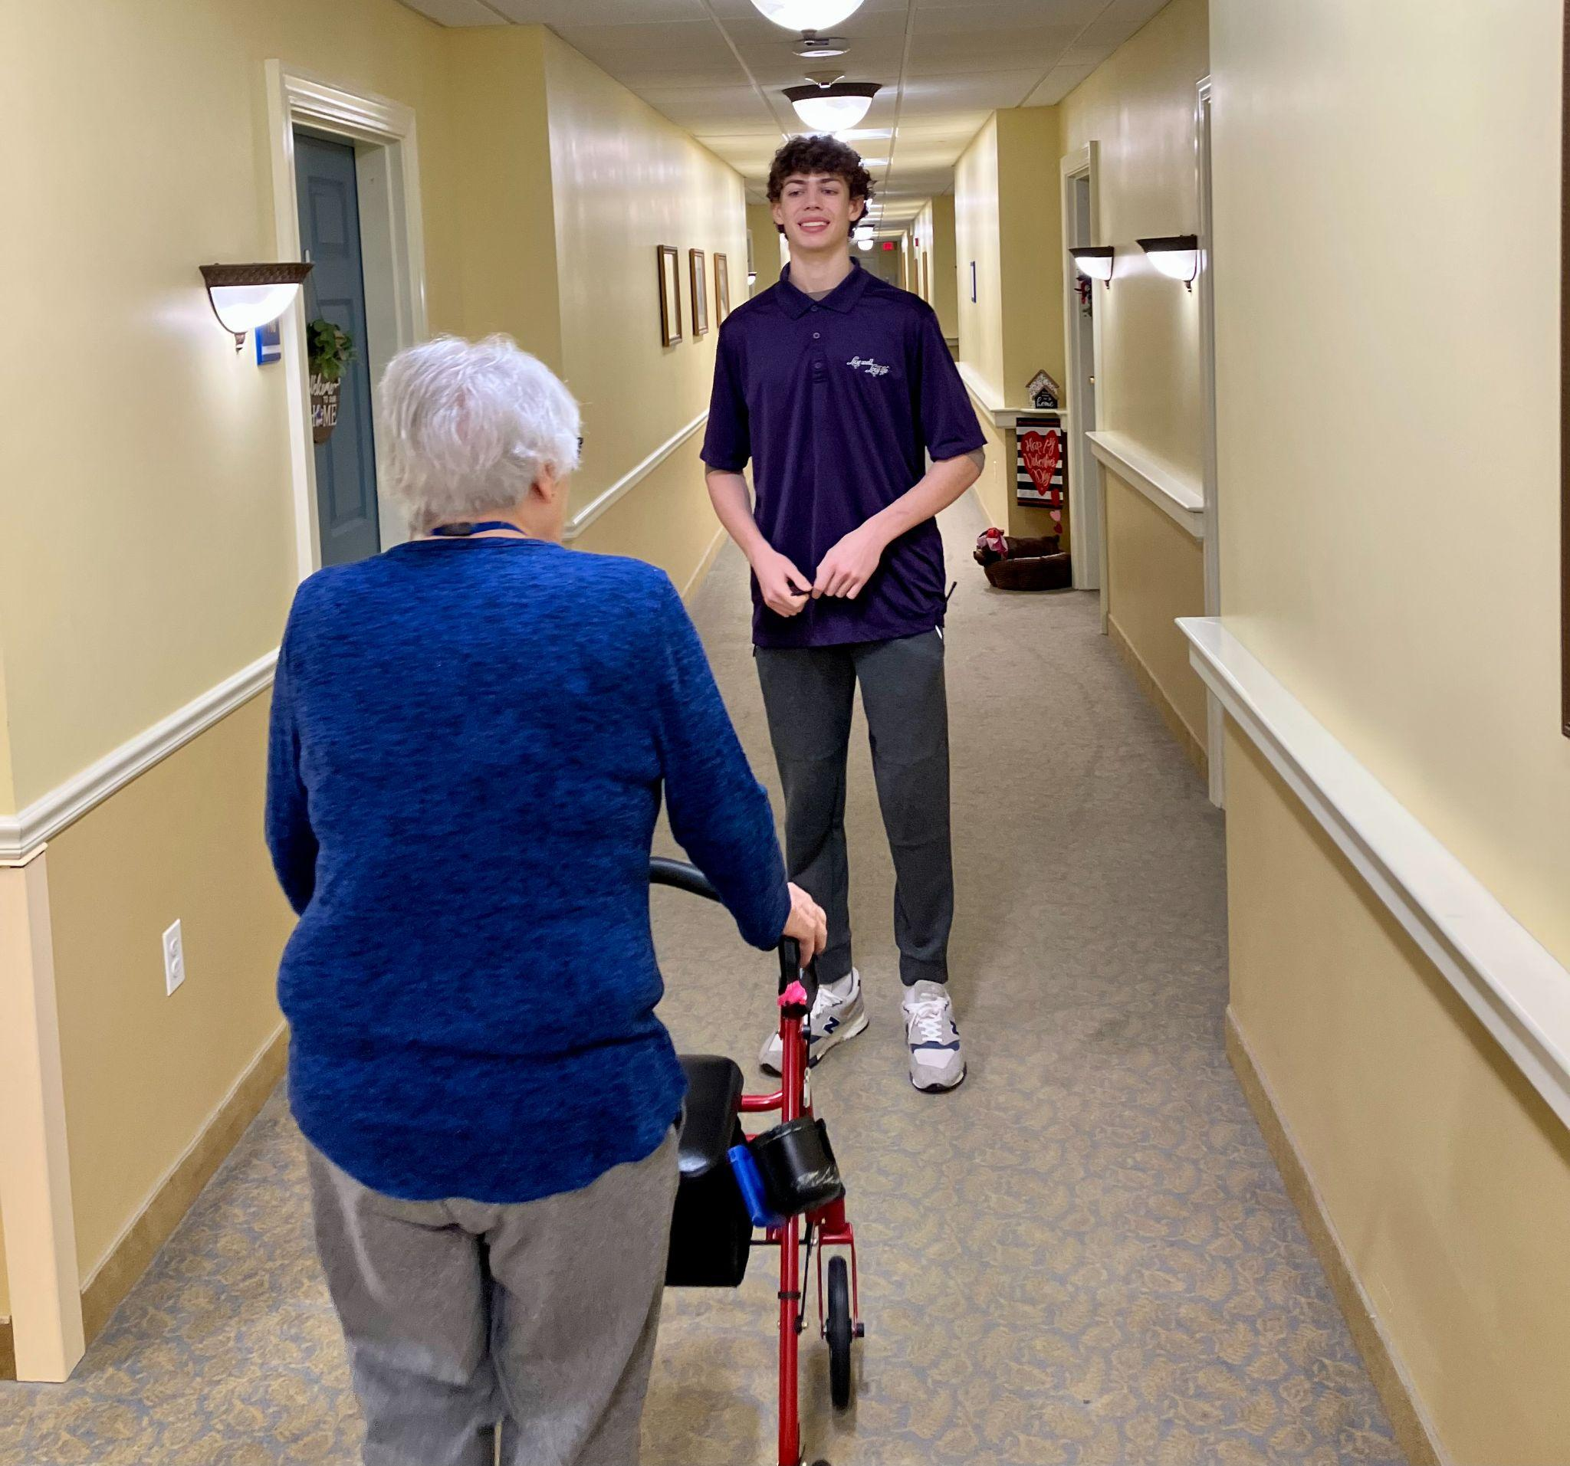
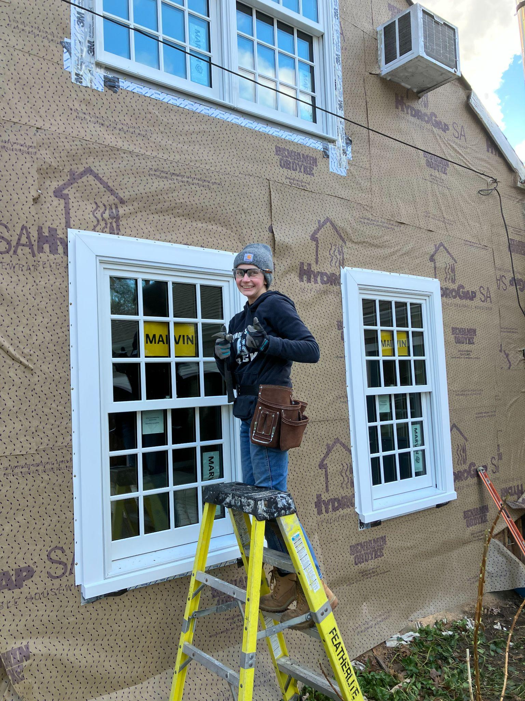
CCTE Highlights 2023 - 2024
Cooperative Education
70 students
New employers: Plymouth Chamber,Blue Bear Plumbing and Beantown of Plymouth.
Six Cosmetology students placed @ area salons: Charles David & Rejuvenations (new MA Apprenticeship Program)
Thankful for our employers! Unmatched, hands-on, real life work experiences.

Slide 10
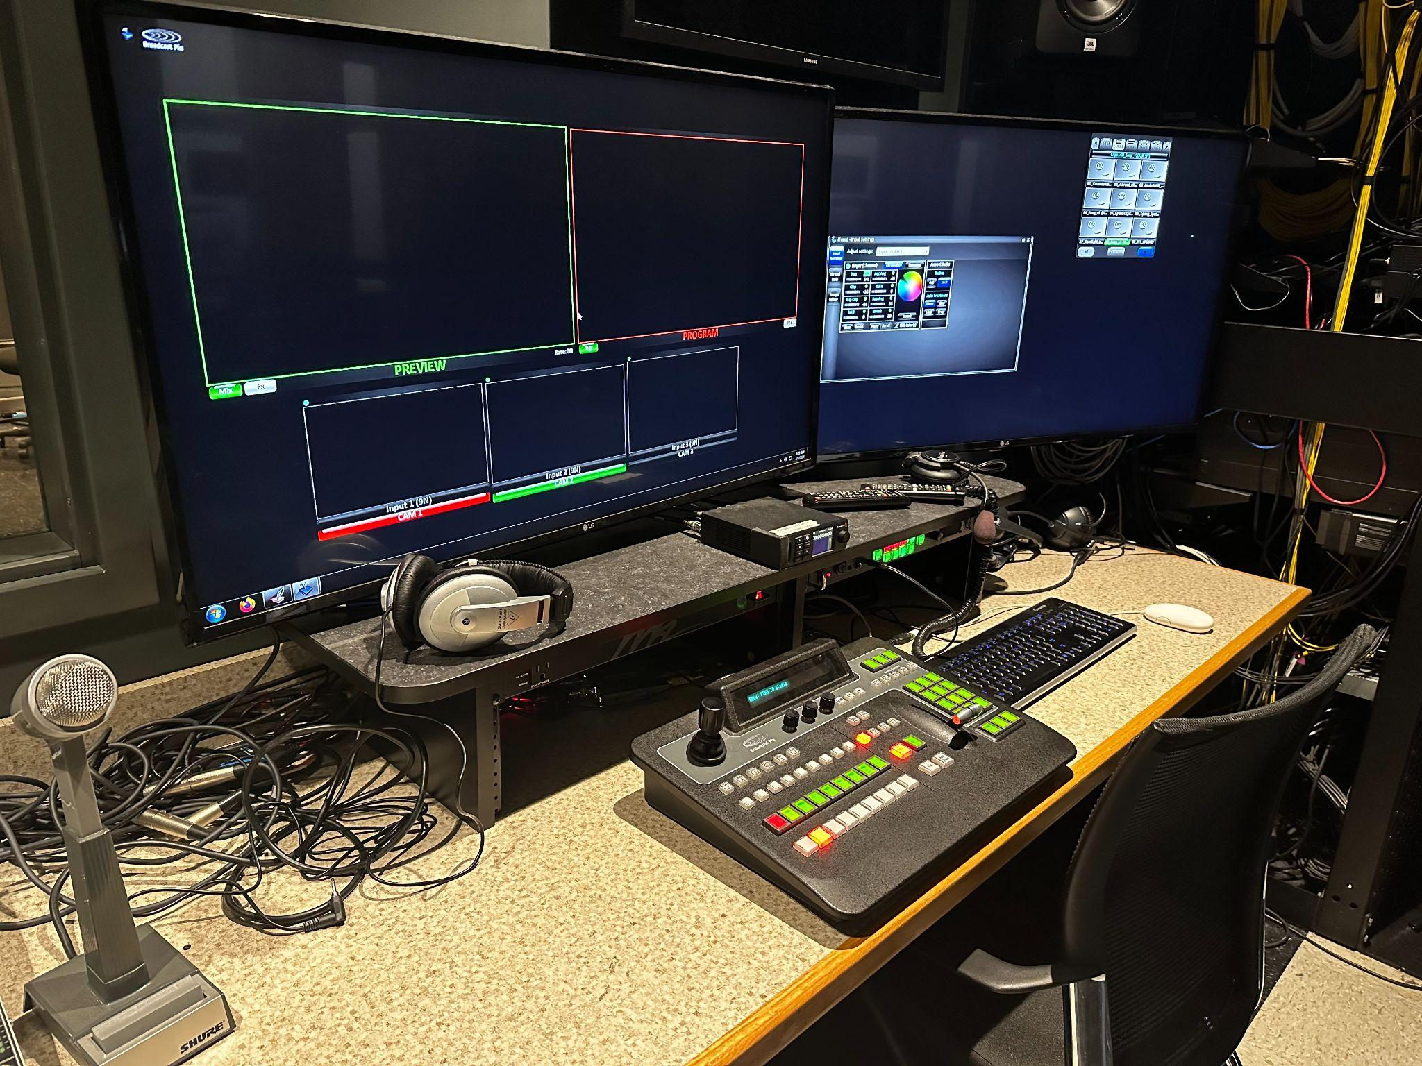
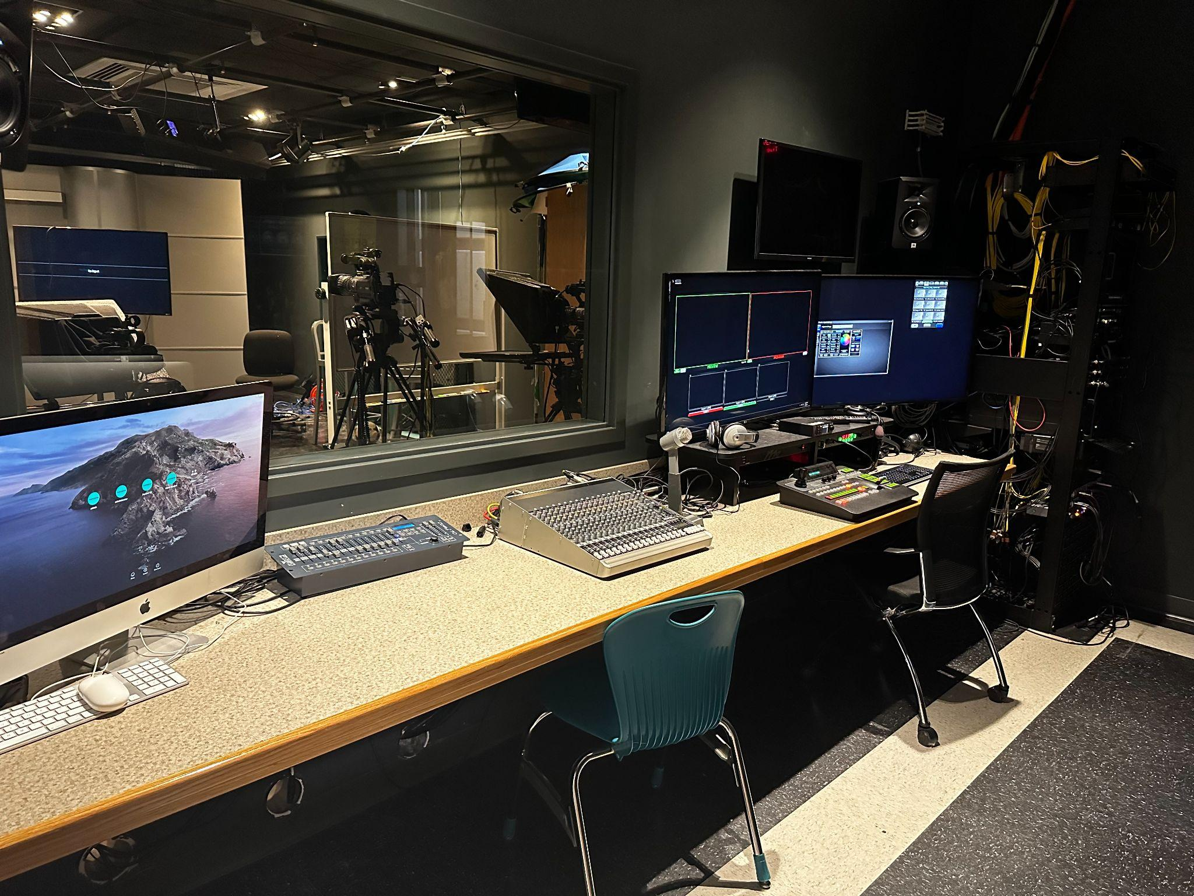
CCTE Highlights 2023 - 2024
Pending Grant for Equipment & Infrastructure
“Staying up to date with workforce needs”
Massachusetts Skills Capital Grant Program
This grant, submitted in March of 2023, supports the update of the PSHS TV Studio
Complete update of equipment that is original to the “old” PSHS studio (2010)
Substantial funding, including In-Kind donations

Slide 11
CCTE Highlights 2023 - 2024
Exploring Grant Opportunities for Equipment & Infrastructure
“Staying up to date with workforce needs”
MASS Clean Energy Center
Equity Workforce Training, Equipment, and Infrastructure Grant
Offshore Wind Works Grant
The grants support both physical and virtual training for climate critical priority occupations:
High Performance Building Occupations (CAD, Carpentry, Electrical, HVAC, & Plumbing)
Offshore Wind Occupations (BCC and NOWI)
Net Zero Grid Occupations (Electrical)
Transportation Sector Occupations (Automotive & Electrical)

Slide 12
CCTE Highlights 2023 - 2024
Exploring Grant Opportunities for Equipment & Infrastructure
“Staying up to date with workforce needs”
MASS Life Sciences
STEM Equipment & Professional Development Grant
Support the integration of Advanced Manufacturing Technological Skills (Engineering Technology)
Potential to partnership with MMA
DESE Grants
Support the integration of Advanced Manufacturing Technological Skills (Computer Aided Drafting)
Potential for a Trades Career Fair
Training Systems & Control Panels (Facilities, HVAC)

Slide 13
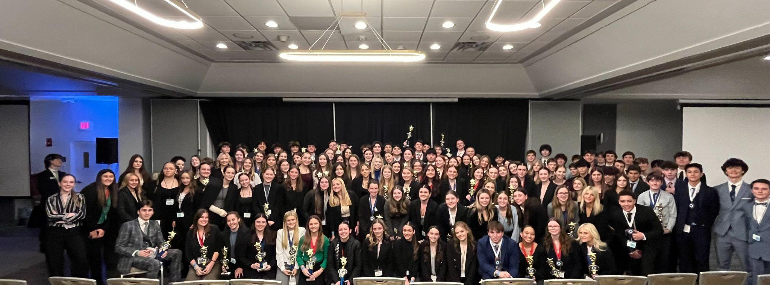
Questions/Comments?
Thank you for your support!

