Slide 1
PLYMOUTH PUBLIC SCHOOLS
STUDENT OPPORTUNITY ACT
SPRING, 2024

Slide 2
STUDENT OPPORTUNITY ACT BACKGROUND:
The Student Opportunity Act (SOA) was enacted in 2019, injecting new funding into the Commonwealth’s educational system, with a focus on providing funding to districts serving students with the greatest needs. The law also included a critical provision that requires every district to set clear targets for improving disparities in achievement among student groups and develop a three-year plan to implement evidence-based strategies to meet their targets.

Slide 3
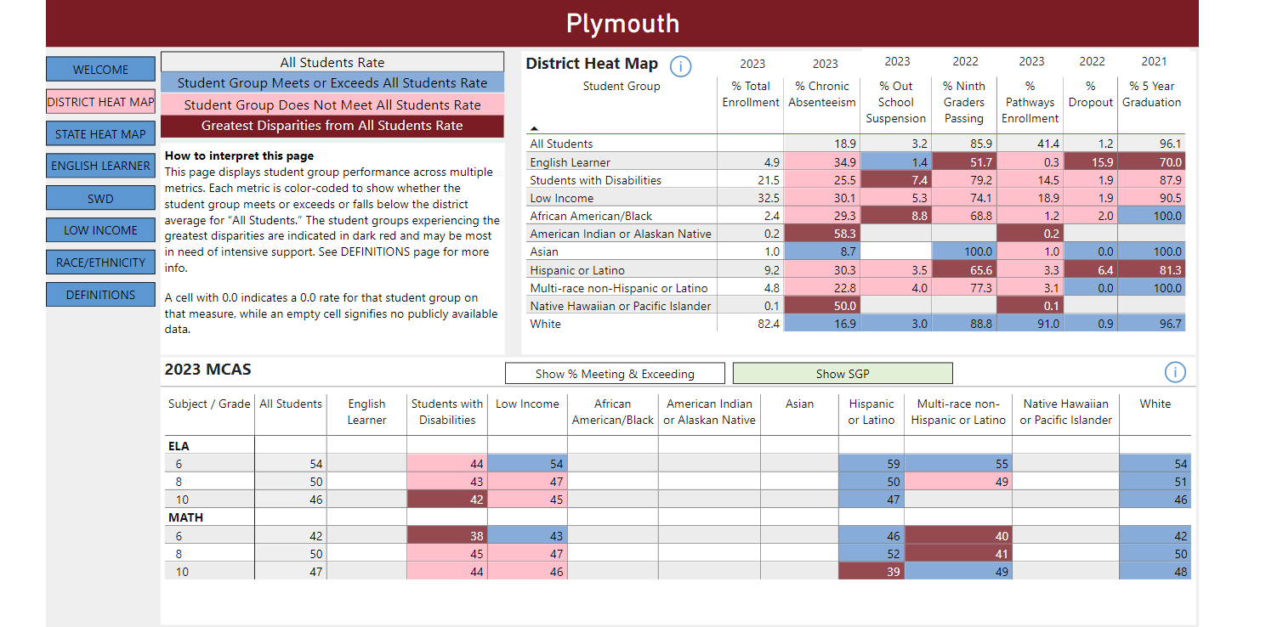

Slide 4
IDENTIFIED GROUPS WITH GREATEST NEED:
English Language Learners
  Chronic Absenteeism
  Ninth Graders Passing
  Dropout Rate
  5 year Graduation Rate
Students with Disabilities
  Out of School Suspension Rates

Slide 5
IDENTIFIED GROUPS WITH GREATEST NEED:
African American/Black
  Out of School Suspension
American Indian/Alaskan Native
  Chronic Absenteeism
  Pathway Enrollment
Hispanic/Latino
  Ninth Graders Passing Percentage
  Dropout Percentage,
  5-year Graduation Rate
Native Hawaiian/Pacific Islander
  Chronic Absenteeism
  Pathway Enrollment

Slide 6
IDENTIFIED GROUPS WITH GREATEST NEED:
ELA MCAS (Student Growth Percentile)
  Students with Disabilities in Grade 10
MATH MCAS
  Students with Disabilities in Grade 6
  Hispanic/Multi-Race or Latino in Grades 6,8,&10

Slide 7
EVIDENCE BASED PRACTICES IDENTIFIED TO ADDRESS DISPARITIES
Focus Area: 1.1 Promote Student' Physical, Mental Health and Wellness
  1.1B-Expand capacity to address SEL and Mental Health needs of students and families by adding staff, partnering with community providers, and strengthen plans to respond to behavioral and mental health needs
  1.1C-Create school environments that include high quality facilities, healthy meals, physical activity, and positive youth development

Slide 8
EVIDENCE BASED PRACTICES IDENTIFIED TO ADDRESS DISPARITIES
Focus Area: 2.1 Select and skillfully implement high-quality and engaging instructional materials that support culturally and linguistically sustaining practices and foster deeper learning
  2.1B-Supporting Curriculum Implementation through high quality professional development
  2.1D-Early Literacy Screening and Support using a reliable screening assessment to identify students who require additional support. Provide research based interventions tailored to each students individual learning needs, delivered by appropriate licenced and trained staff.

Slide 9
EVIDENCE BASED PRACTICES IDENTIFIED TO ADDRESS DISPARITIES
Focus Area: 2.2 Use MTSS process to implement academic supports and interventions that provide all students, particularly students with disabilities and multilingual learners equitable access to deeper learning.
  2.2A-Train all staff to effectively employ the WIDA framework so they can provide effective scaffolds and supports for multilingual learners
  2.2D-Develop or expand co-teaching and other evidence based models that leverage collaboration to best serve students with disabilities and multilingual learners

Slide 10
HIGH LEVEL INVESTMENTS:
Professional Development
Program Adjustments to Ensure Equal Access to High Quality Instruction and Instructional Materials
Early Literacy Screening
Implementation and Fidelity of Child Study Team Practices
Collaborative Co-Teaching Model
Safe/Supportive Environments for all Students and their Families
Range of Program Options Responsive to the Needs of Diverse Learners
Expanding Access to Preschool
Extended Learning Time/Activities

Slide 11
THE DISTRICT WILL UTILIZE THE FOLLOWING FUNDING SOURCES TO BE ALLOCATED TOWARD EVIDENCE BASED PRACTICES FOR THE NEXT THREE YEARS:
Title I
Title IIA
Title III
Title IV
IDEA
Inclusive PK
Local Educational Agency Budget
Perkins
Other competitive grants as available and as appropriate

