Slide 1



Solar Power Purchase Agreements:
School Committee Update
10/21/24

Slide 2

Buildings, Energy, and Infrastructure
Action BEI 2.2.A - Identify opportunities for microgrids and energy storage for critical facilities.

Slide 3
Solar PPA Project - Provide solar at 5 locations:
  Plymouth Public Library (132 South St.)
  DPW Headquarters (159 Camelot Dr.)
  Plymouth South High School (490 Long Pond Rd.)
  Plymouth North High School (41 Obery St.)
  Cedarville Landfill (31 Hedges Pond Rd.)

Slide 4
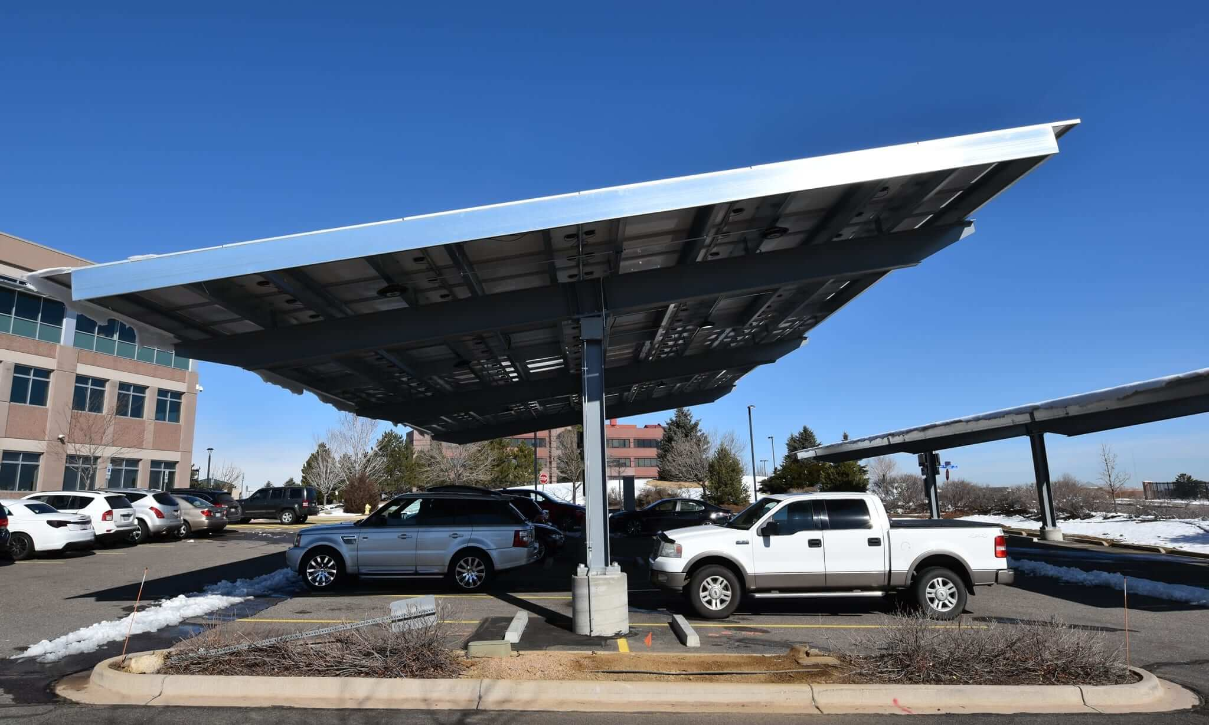
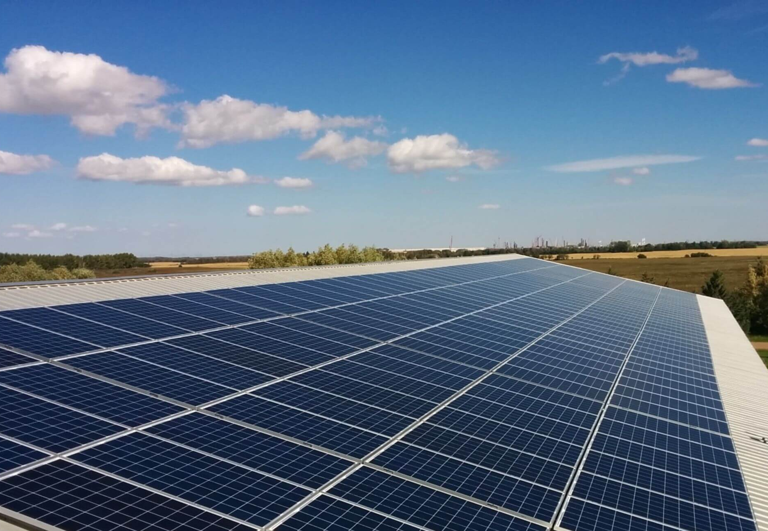

Slide 5
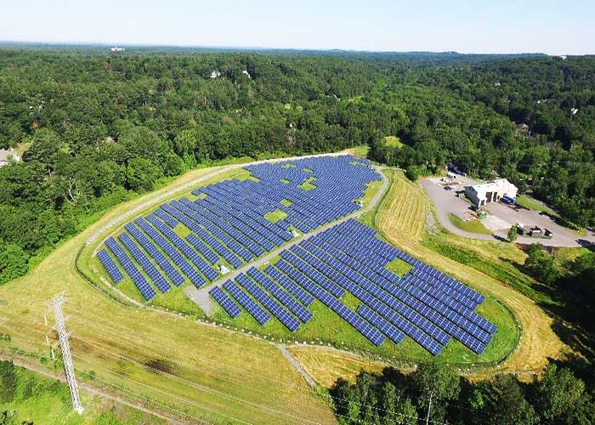

Slide 6
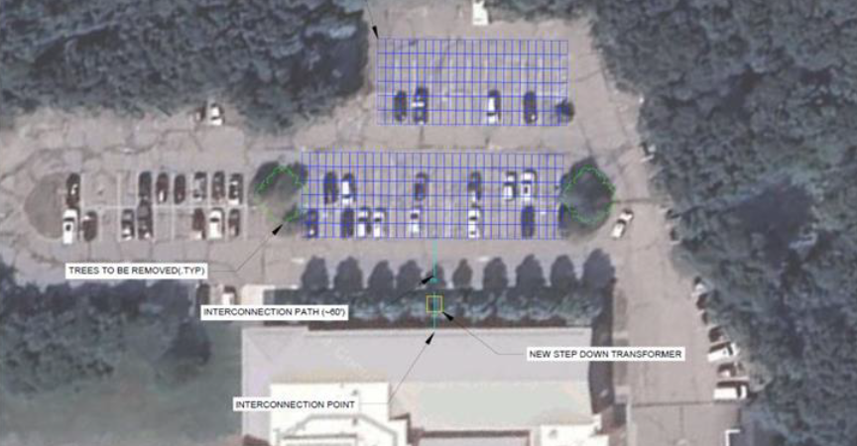

Slide 7
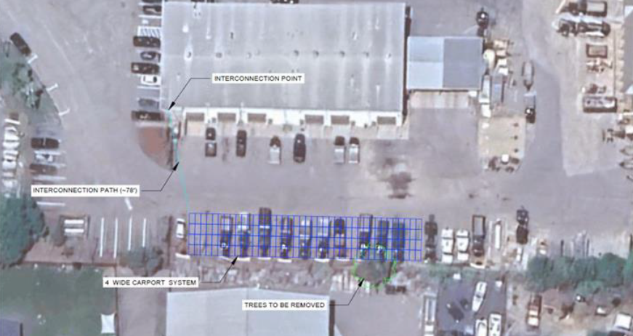

Slide 8
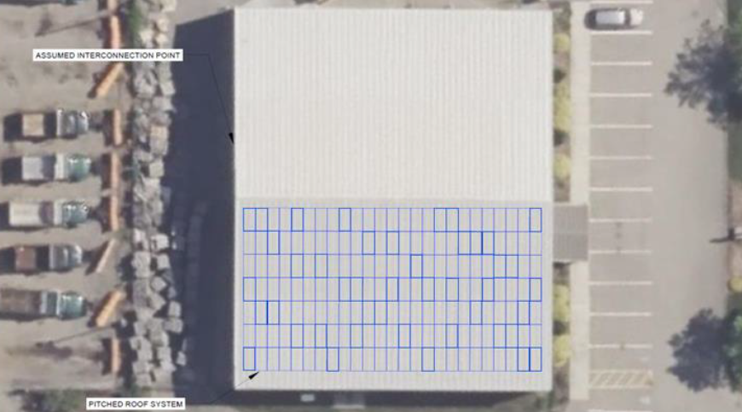

Slide 9
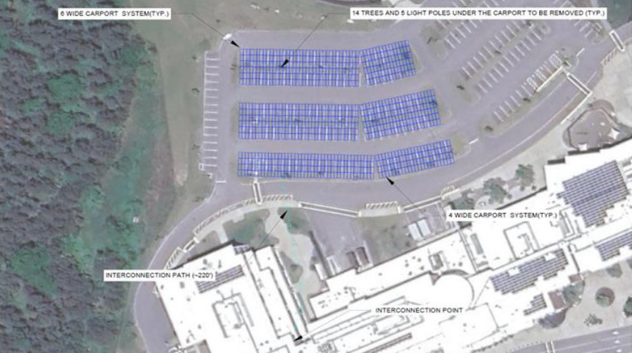

Slide 10
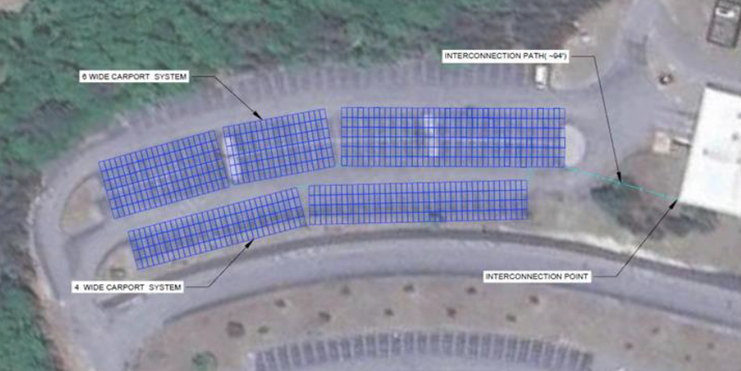

Slide 11
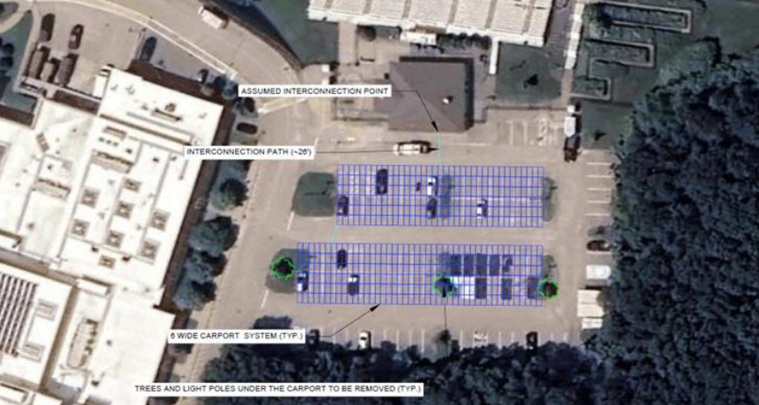

Slide 12
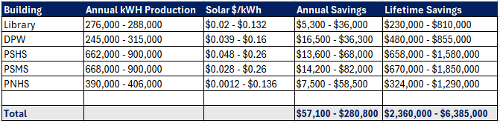

Slide 13
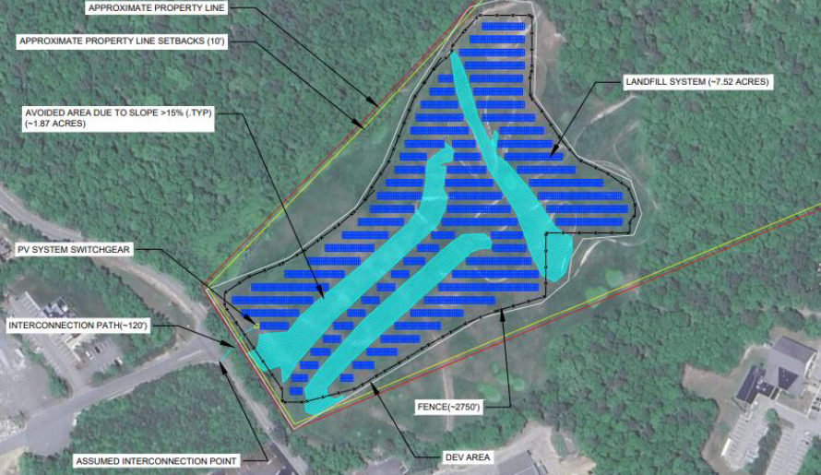

Slide 16
Timeline:
Securing approvals: October 30th, 2024
Town executes contract with vendor: January 1st, 2025
Submit for Eversource Interconnections: January 30th , 2025
Submit SMART applications: Q3 2025
Construction: January – June 2026

