Slide 1

Nathaniel Morton Elementary School
2024-2026 School Improvement Plan Update

Slide 2
School Council Members
Liana Delaney
Kate Engel
Kristine Chase
Joanna Flaherty
Colleen Kudrikow
Tricia Novak
Jen Palladino
Alan Rezendes
Erin Sharon
Michael Spencer
Siobhan Spidle

Slide 3
Vision, Mission and Values
In accordance with the Plymouth Public schools, our vision is to develop confident, critical thinkers, productive and creative life-long learners and socially responsible, engaged citizens capable of adapting to change in a technologically advanced and multi-cultural society.
To create a school where every student is given the tools to excel, flourish and develop a sense of identity and to enhance learning, connections and enjoyment of all our students.
Our mission and vision work in conjunction to support of our core values which are to create:
Competent students
Resilient children
Engaged learners
Welcomed individuals

Slide 4
NMES - By the Numbers
Current Enrollment: 515 students
24 General Education Classrooms
District-wide program - Bridge Classroom serving grades 3, 4 & 5
English Language Learners % - 9.2
Economically Disadvantaged Students- 35.5 %
Students with Identified Disability - 16.2%

Slide 5
Data Dive
District Data:
Grade 1 NM/PM Fall Early Literacy 35%
Grade 1 NM/PM Winter Early Literacy 15%
Grade 2 NM/PM Fall Literacy 25%
Grade 2 NM/PM Winter Literacy 10%
State Data
2023 MCAS: % Exceeding or Meeting
Gr 3 ELA: NMES - 54% State: 44%
Gr 3 Math: NMES - 53% State: 41%
Gr 4 ELA: NMES - 50% State: 40 %
Gr 4 Math: NMES - 50% State: 45%
Gr 5 ELA: NMES - 52% State: 44%
Gr 5 Math: NMES - 49% State: 41%
Gr 5 STE: NMES - 44% State: 42%

Slide 6
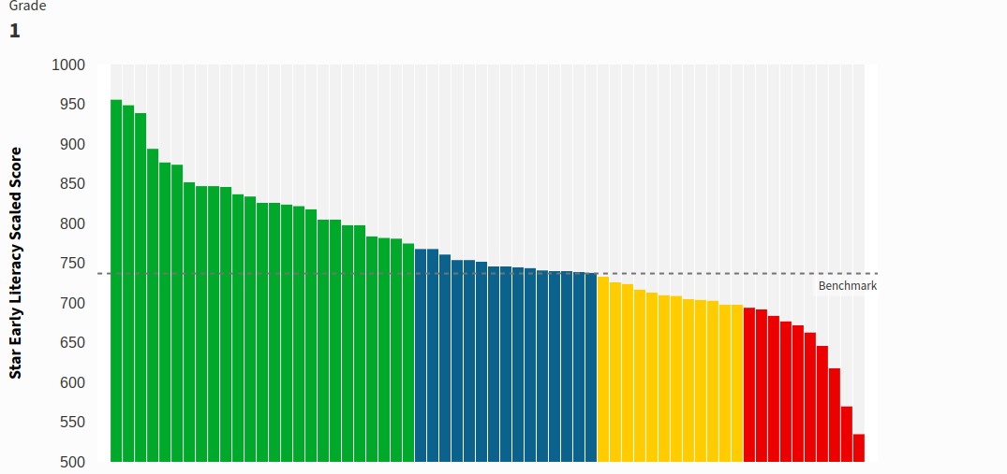
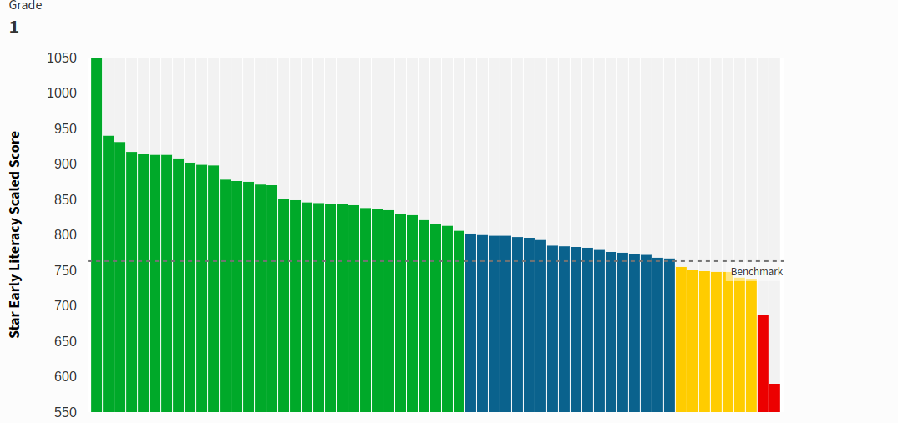
Fall Data
Winter Data
Grade 1 Early Literacy Data (Fall to Winter)

Slide 7
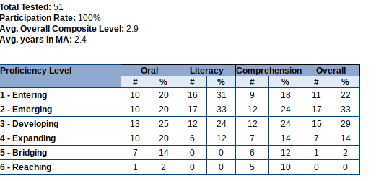
DART Comparison - Ranked 2nd in Student Growth Percentage and Exceeding/Meeting Percentages
NMES Making Substantial Progress to Accountability Targets (62%)
Higher Student Growth in ELA/MATH MCAS Areas for All Students, High Needs and Students with Disabilities compared to district and state benchmarks.
In five of the seven MCAS assessments had 10%+ students Not Meeting Expectations
57% EL students met their progress
target
State Data Points

Slide 8
Strategic Objective 1: Academic Success
Establish data meetings across content areas with responsive intervention systems within and across grades.
If a more consistent approach to data analysis and responding interventions are assigned in a responsive teaching approach then all students will increase proficiency across academic areas measured by district and state assessments.
Expected Outcomes:
*Decrease number of students in all grades receiving screening scores of NM/PM from Fall to Spring benchmarks.
*By the end of the plan, our “all school” Not Meeting percentage on MCAS scores are below 5% and that all subgroups have shown a percentage decrease from the 2023 threshold.
*Intervention approaches observed and shared through school-based learning walks.
*At least three new intervention resources/strategies per content area are identified and utilized.
Strategic Objective 24-25: Create a data review timeline and identify assessments utilized for each content area.

Slide 9
Strategic Objective 2: Student Engagement
Provide opportunity and guidance for student goal setting, voice and choice.
If there is an increase in student agency and goal setting then students will move from passive to active engagement in their learning
Expected Outcomes:
*Creation of Grade Level Engagement Rubrics
*See an increase of driving engagement behaviors from students during teacher self-reflections across the year.
*Three to five professional opportunities per grade for engagement observations and discussions
Strategic Focus 24-25: Develop student engagement criteria and rubric.

Slide 10
Strategic Objective 3: Social Emotional Wellness
Provide direct instruction and authentic experiences for social interaction.
If students are given more direct instruction around the social competencies and purposeful social interaction then students will form more positive peer relationships and develop greater sense of community and connection.
Expected Outcomes:
*Reduction of behavior referrals from lunch/recess times.
*Increase in positive comments related to peer relationships and personal social skills based on feedback surveys taken by students.
*By end of plan, grades 1 & 2 develop at least two purposeful play activities to integrate into social studies and science standards while addressing identified SEL competencies.
Strategic Focus 24-25: Grade level teams identify curriculum areas for SEL integrated activities/centers (i.e. turn taking, fair play, managing emotions, perspective taking)

Slide 11
Strategic Objective 4:
Family Communication/Shared Decision Making
Provide frequent opportunities to allow for family feedback about student learning and school experience.
If our communication with families continues to extend beyond logistical information and into goal sharing and decision making then we will have a shared partnership for student growth.
Expected Outcomes:
*Increased participation at both assigned family/teacher conference times.
*At least three actionable and targeted areas for continuous school improvement are identified from feedback forms and sessions.
*Increased evidence of family engagement in shared decision making.
Strategic Focus 24-25: Provide listening opportunities for the new principal to hear from families on targeted topics.

Slide 12
Strategic Objective 5: Equity and Inclusive
Enhance language development instructional strategies.
If staff enhances their understanding of language development then we will see a more responsive, inclusive setting for EL learners.
Expected Outcomes:
*Increased number of EL students meeting or exceeding their Access target scores.
*Language objectives evidenced in 80% of learning walk-throughs.
*See an increase of speaking domain represented in tally charting across classrooms.
Strategic Focus 24-25: Establish peer visits and observations across settings and models that support language development.

Slide 13
NMES - A Look Back
23-24 CREW Journey
NMES Beyond the Day:
Ukulele Club
Art Techniques Workshop
Robotics
Girls on the Run
Chorus
Band/Orchestra
PTA Events:
Fall Festival; Winter Wonderland; Love of Reading Book Fair

