Slide 1
Children’s Business Fair Awards
November 27, 2023

Slide 2







A Special “Thank You” to…

Slide 3
Elementary School Advisors
Cold Spring - Jolie Dwyer & Megan Milano
Federal Furnace - Lisa Whynott
Hedge - Carin Marini
Indian Brook - Erin Kirkpatrick
Manomet - Nancy Cavicchi & Katie Strout
Nathaniel Morton - Courtney Minassian
South - Jennifer Powers
West - Heather Mento
District Wide - Erica Manfredi, Kelly Bitinas,
Jen Mulvaney

Slide 4
Plymouth Community Mentors
Katie Kearney - Plymouth Public Library Foundation
Laura Scott - Viscariello Hospitality
Phillip Tingale - Viscariello Hospitality
Nina Garcia - ValPak
Daniel Genannt - Cape Cod Five
Kelly Le - Cape Cod Five
Marcia Mantell - Mantell Retirement
Linda Dooley - IMAGEination Graphic Solutions
Kim Sweeney - Engel & Volkers Real Estate
Bob Nolet - Plymouth Area Chamber of Commerce
Alyssa Smith - Locally, Yours
Pamela Smith - Locally, Yours & Creative Pear Marketing
Christine de la Torre - Sprezzatura
Maryann McClellan - Nectar Collective
Scott Hokanson - Brabo Benefits

Slide 5
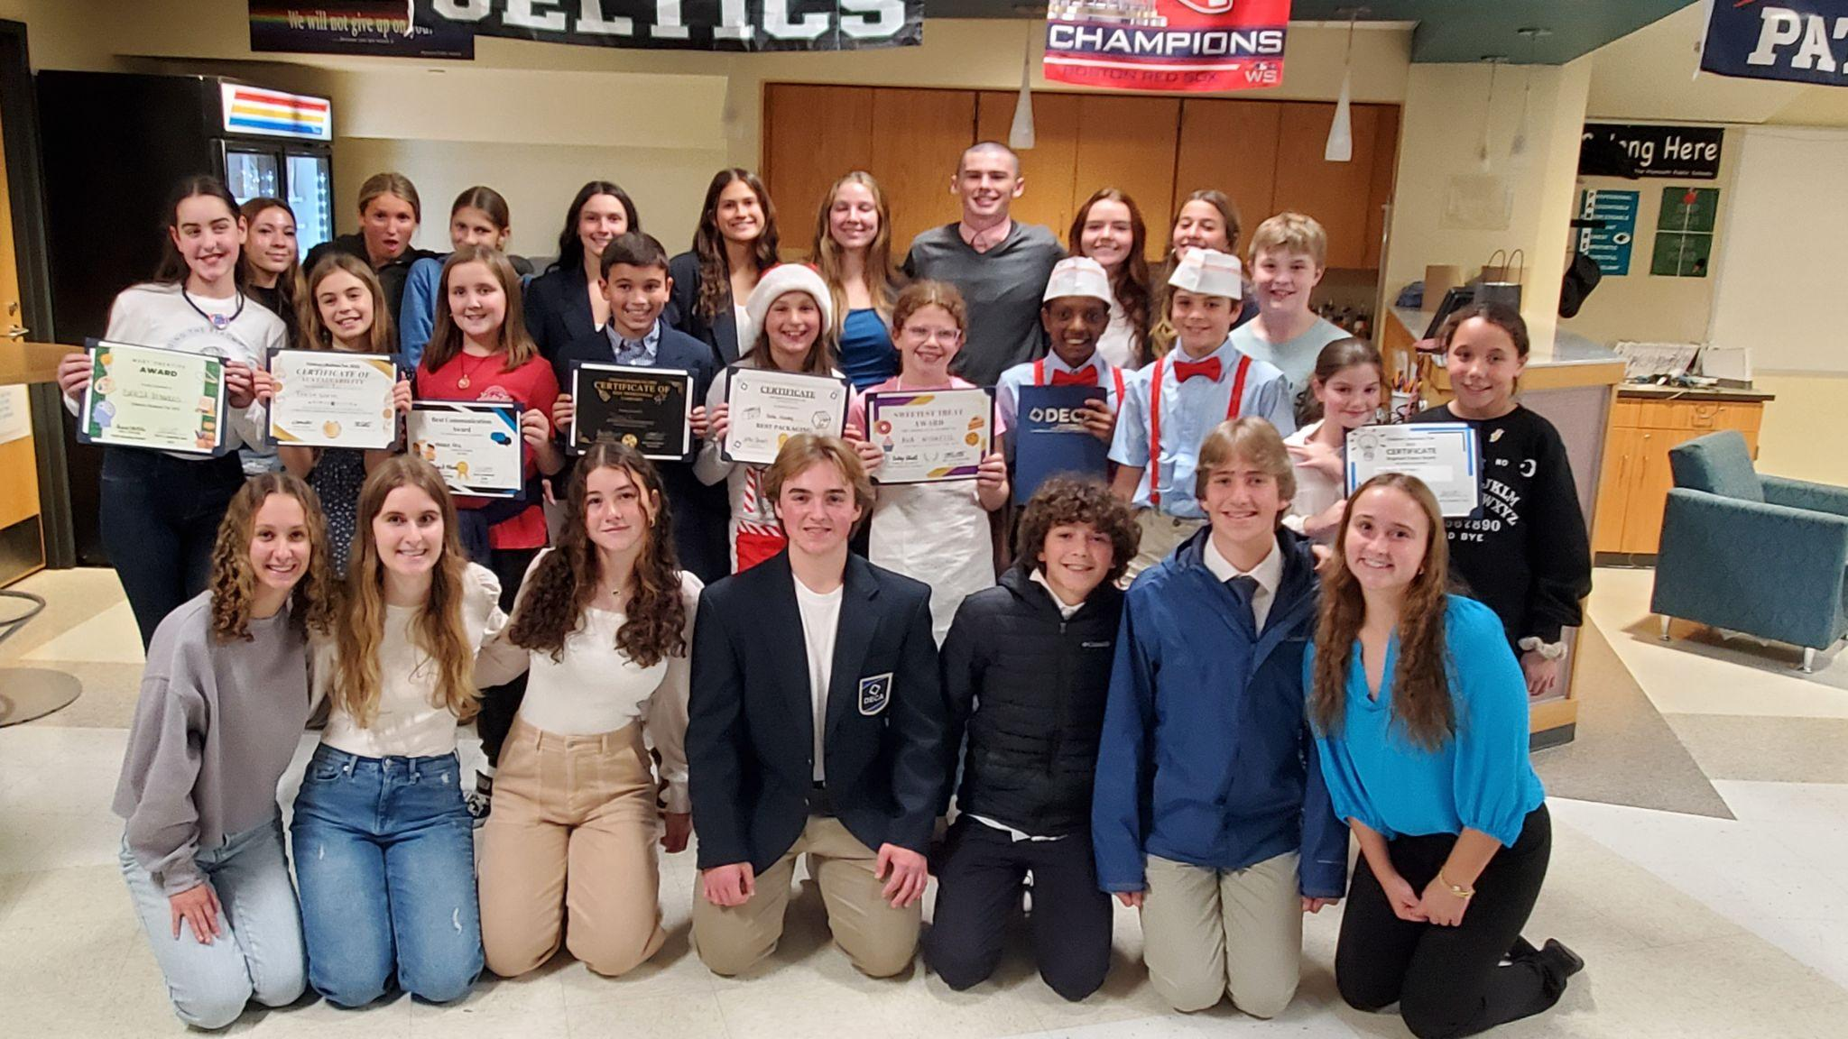
Children’s Business Fair Award Recipients
Courtesy of Plymouth South High School DECA Students, Yvonne O’Keefe Advisor
Best Communication - Maggie Fey, Peace & Art
Best Display - Landon Petti & Alazar Hastings, The Popcorn Bros
Best Packaging - Bella Finley, Bella’s Christmas Creations
Best Promotional Campaign - James Garcia, James’ Chocolate Covered Chex Mix
Brightest Future - Aleigha Sena, Kenli McManus, K & A Mystery Candles
Most Creative - Dahlia Reynolds, DLR Designs
Most Sustainable - Reese North, Art From The Ocean
Sweetest Treat - Ava Nighelli, Ava’s Baked Delights
Uniqueness - Colin Hokanson, Colin’s Carpentry

Slide 6
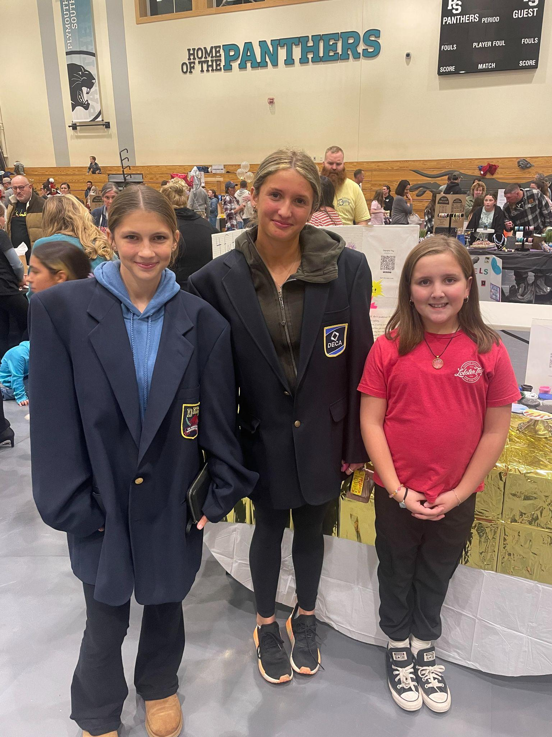
Best Communication - Maggie Fey, Peace & Art

Slide 7
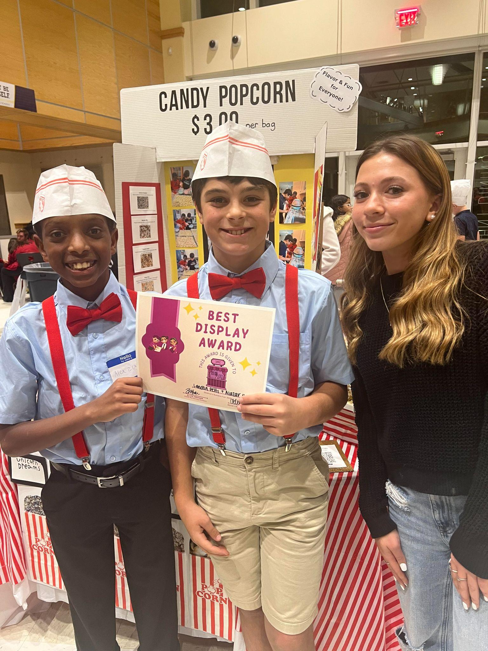
Best Display - Landon Petti & Alazar Hastings, The Popcorn Bros.

Slide 8
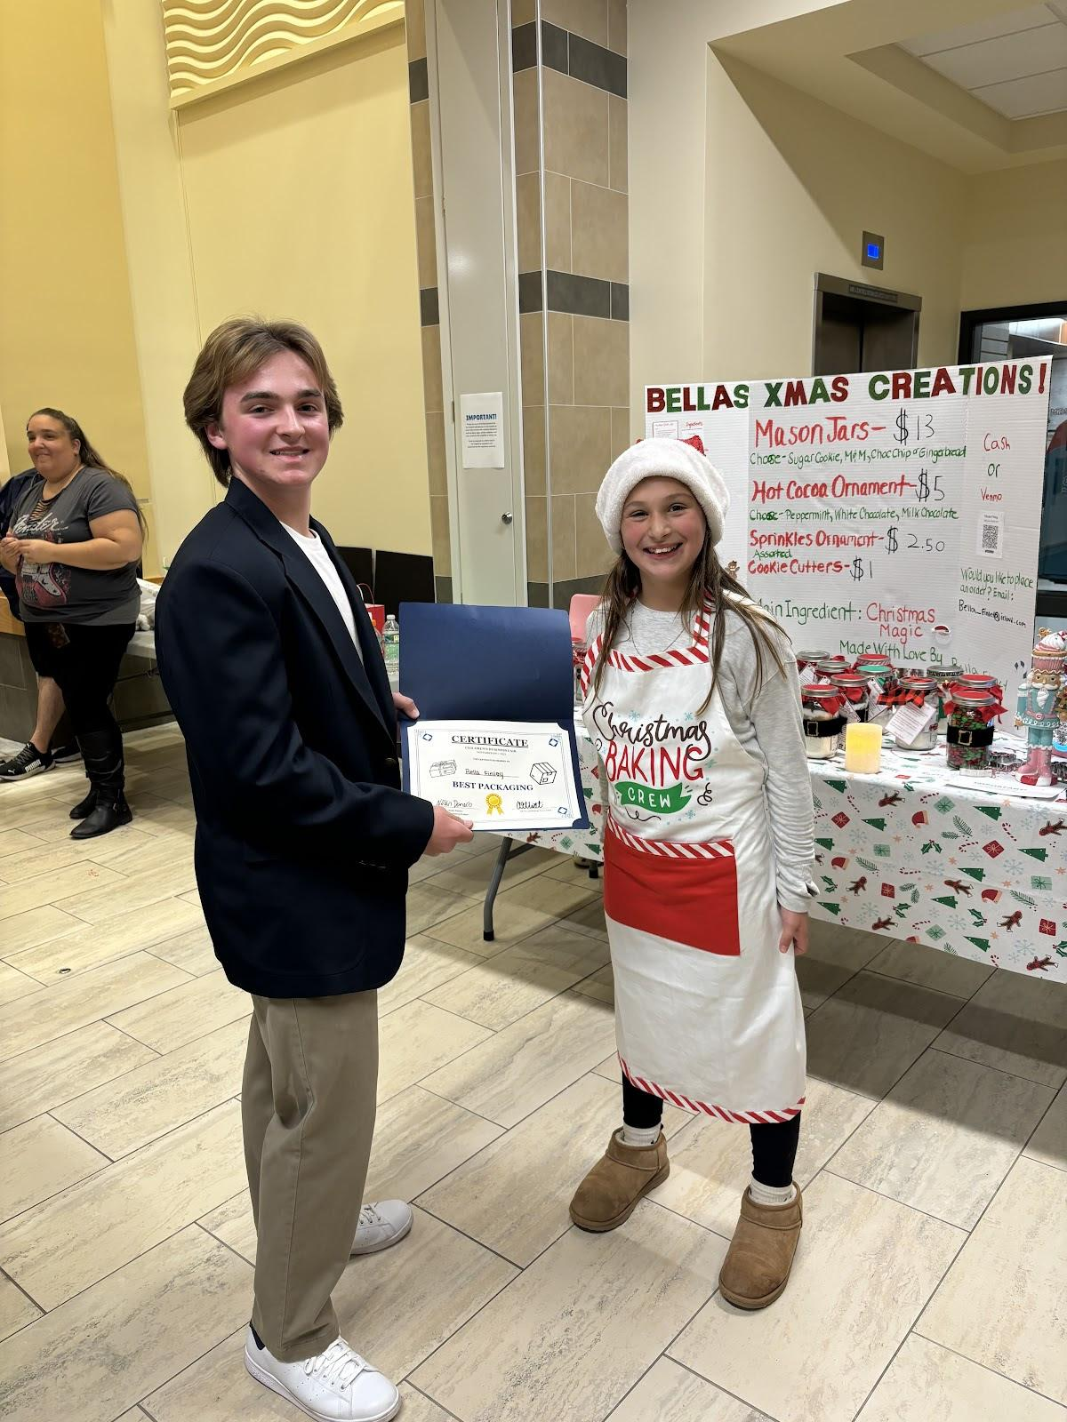
Best Packaging - Bella Finley, Bella’s Christmas Creations

Slide 9
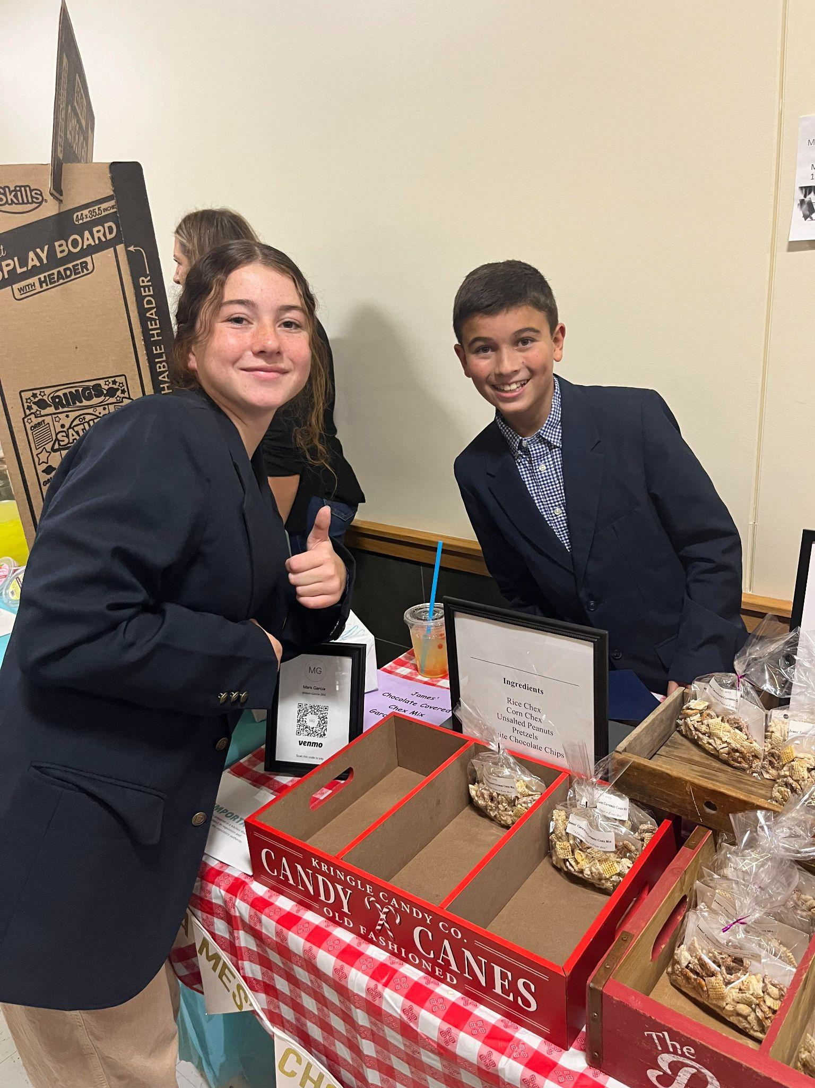
Best Promotional Campaign - James Garcia, James’ Chocolate Covered Chex Mix

Slide 10
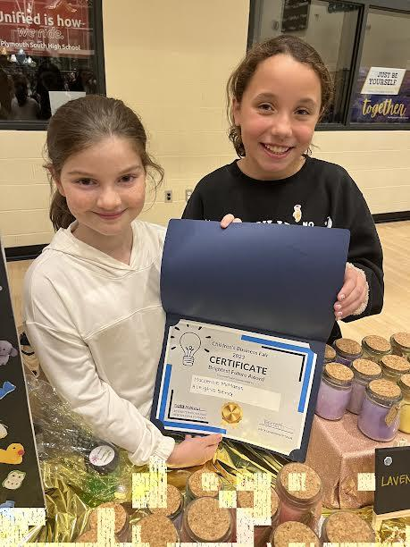
Brightest Future - Aleigha Sena, Kenli McManus, K & A Mystery Candles

Slide 11
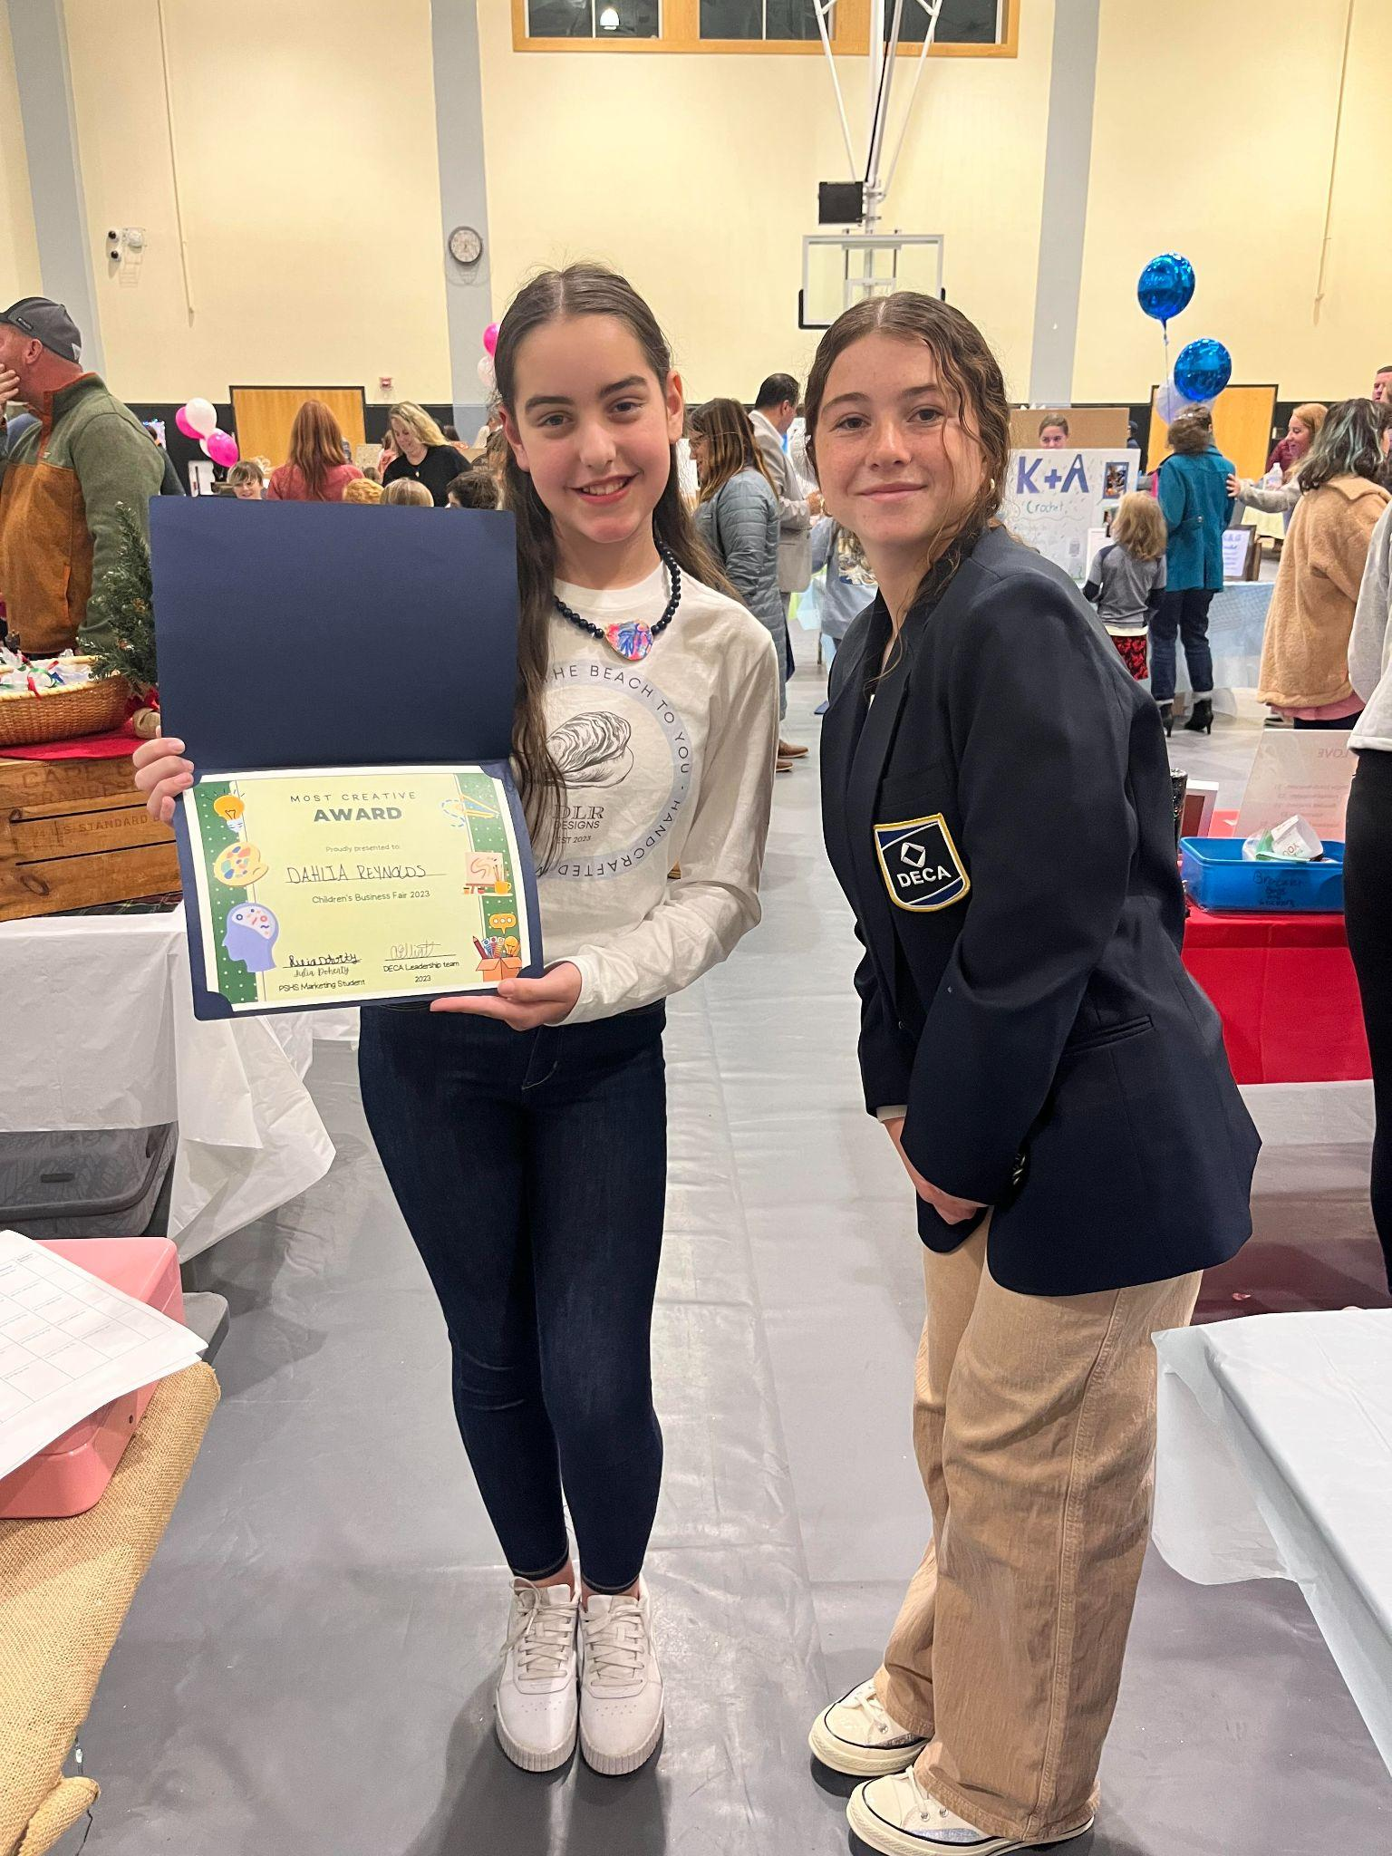
Most Creative - Dahlia Reynolds, DLR Designs

Slide 12
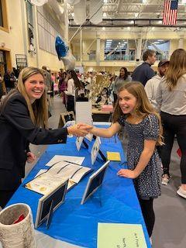
Most Sustainable - Reese North, Art From The Ocean

Slide 13
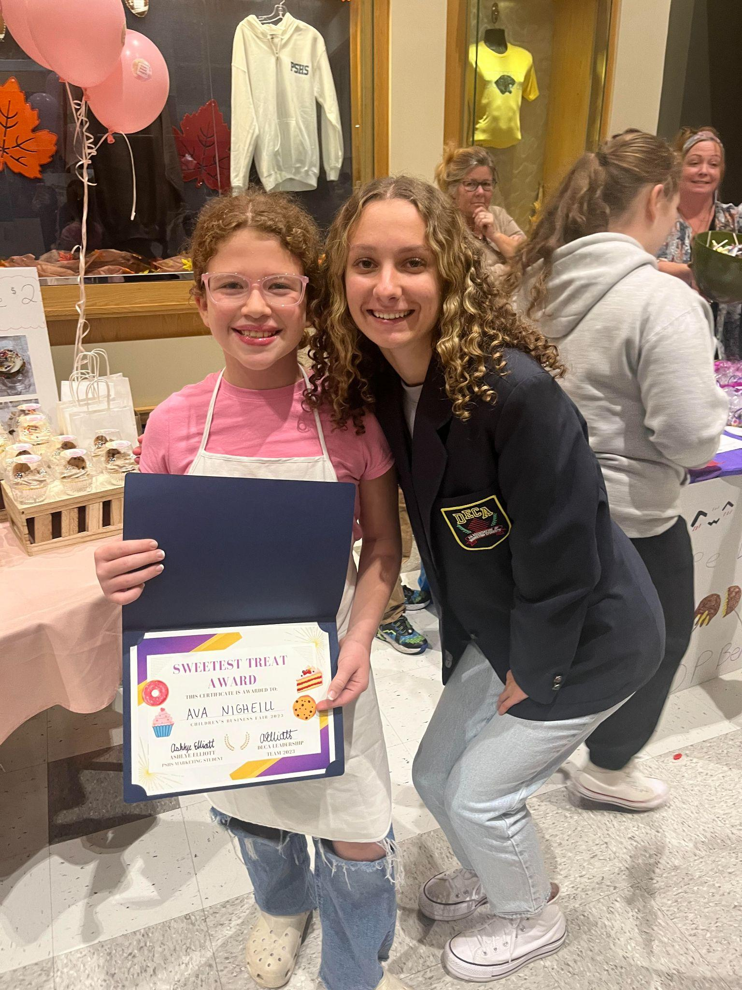
Sweetest Treat - Ava Nighelli, Ava’s Baked Delights

Slide 14
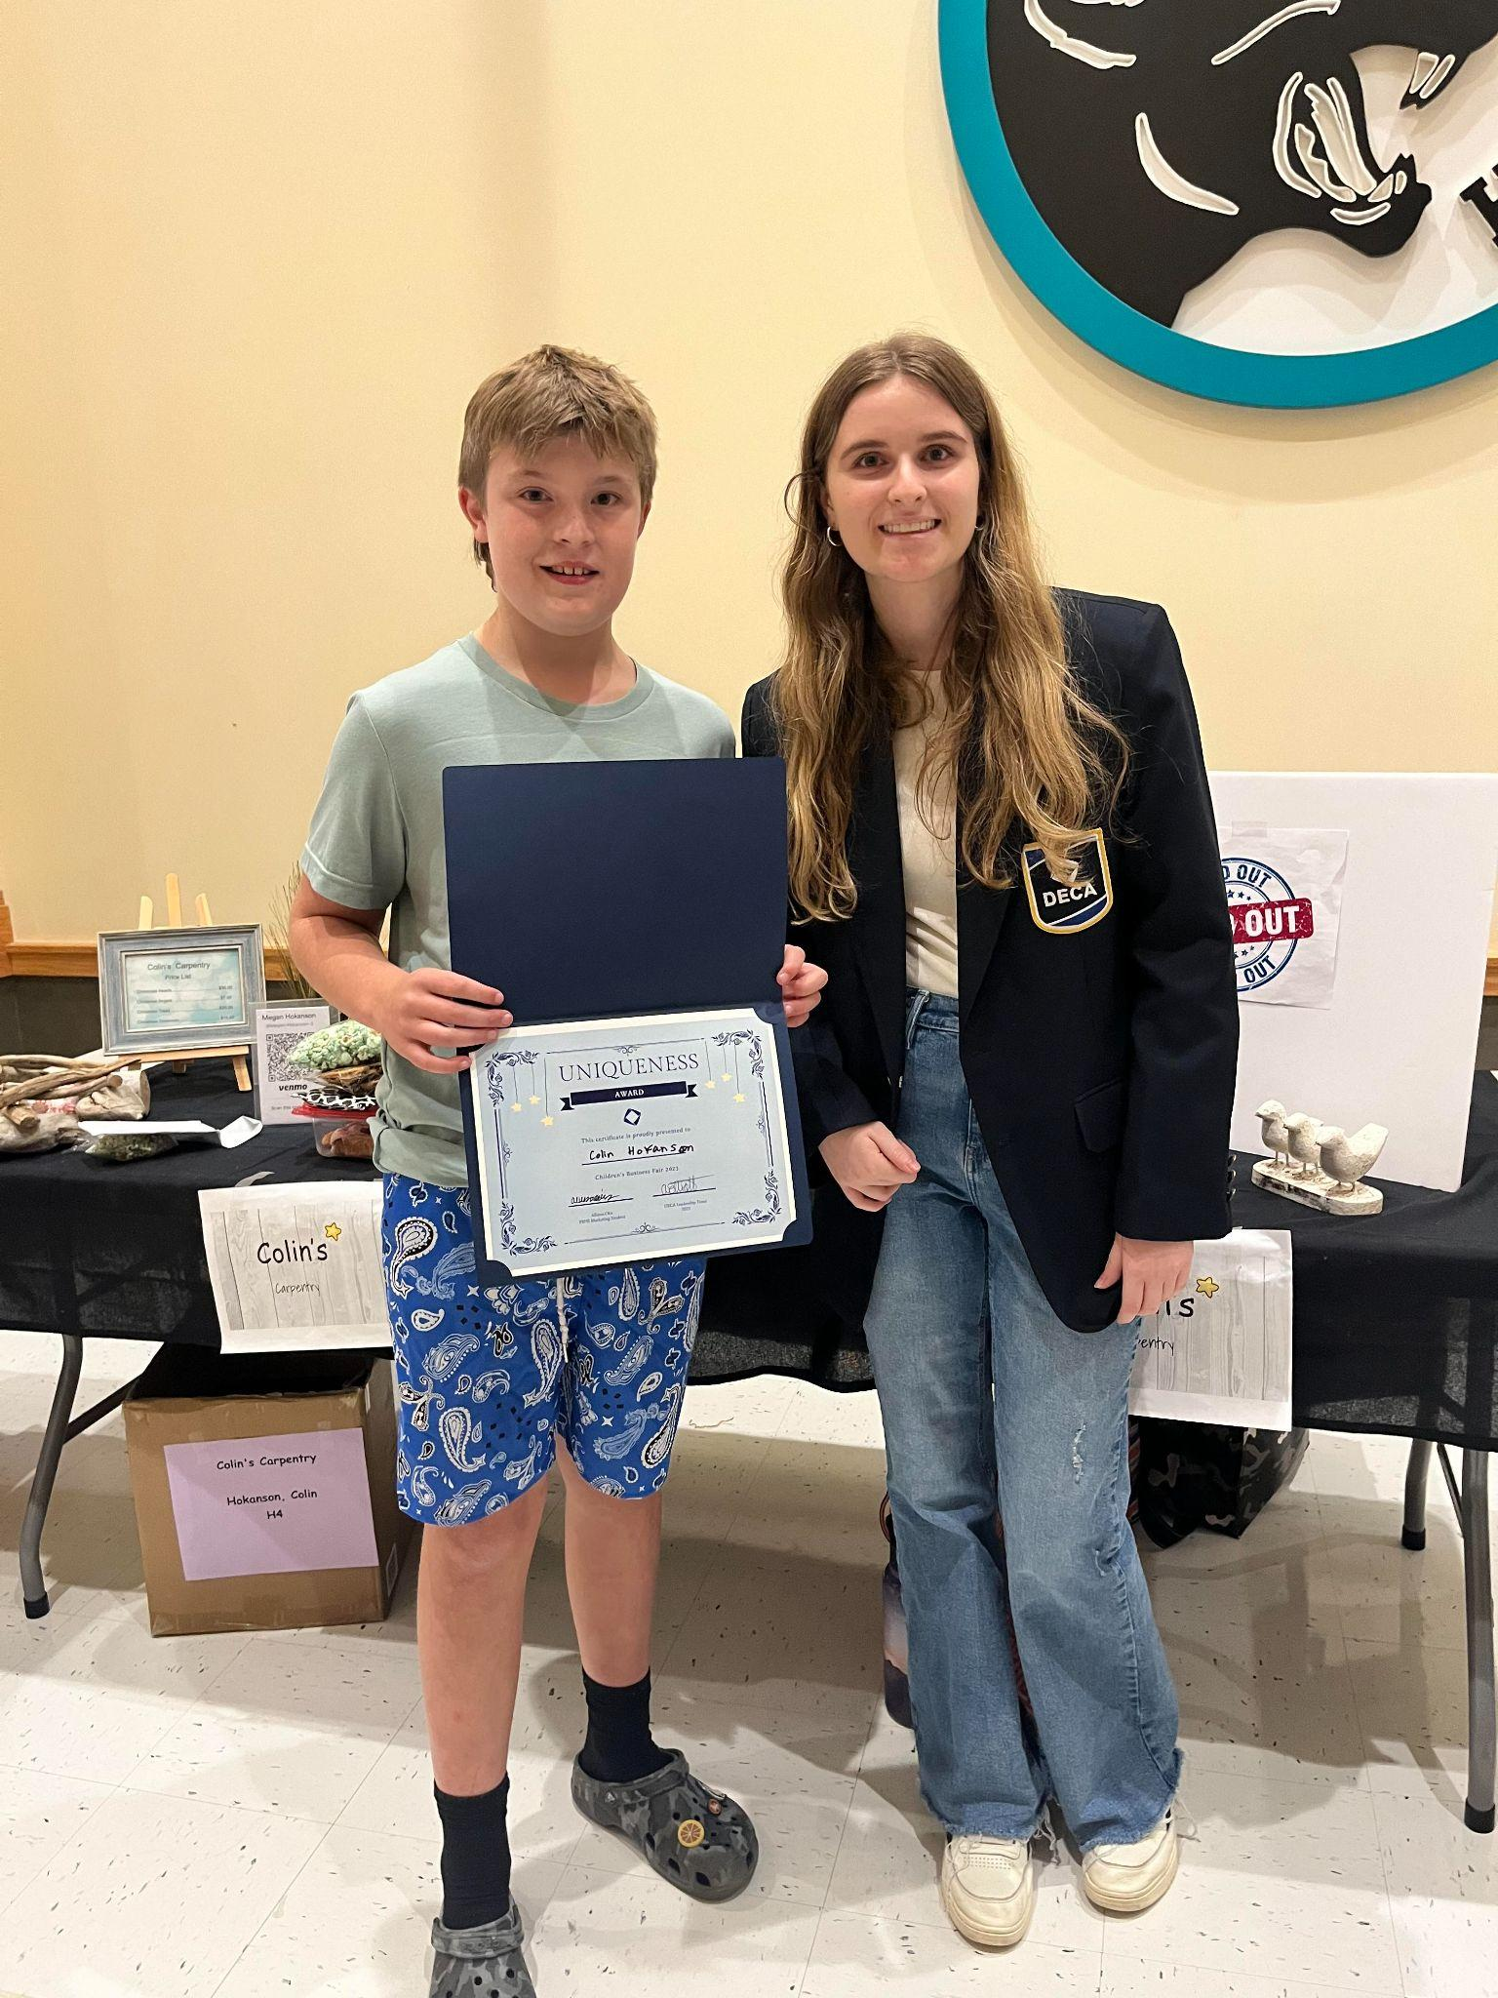
Uniqueness - Colin Hokanson, Colin’s Carpentry

Slide 15

Save the Date!!
The 4th annual Children's Business Fair
will take place during the Fall of 2024
Stay tuned!!!

